Slide 1
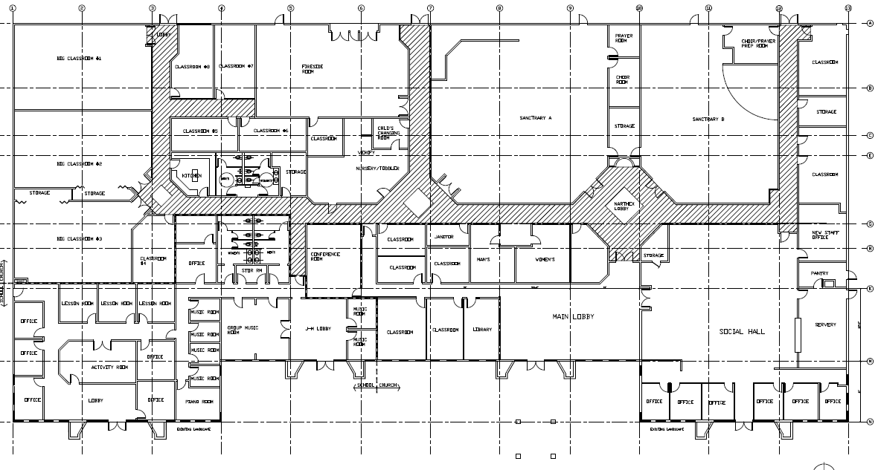
Conf room

Slide 2
 | CCIC- Cupertino Remodel
 |  | 9/14 | 10/14 | 11/14 | 12/14 | 1/15 | 2/15 | 3/15 | 4/15 | 5/15 | 6/15 | 7/15
 | Design Phase
 | City Permit
 | Tenant Relocation
 | Bid Phase
 | Demolition
 | Construction-Phase 1
 | Construction-Phase 2
 | Completion
 |  | Design |  | Permit | General Condition |  | Demo | Construction/ Furniture
 | Budget Need |  | $ 80,000 | $ 20,000 | $ 20,000 | $ 20,000 | $ 100,000 | $ 240,000 | $ 240,000 | $ 240,000 | $ 240,000
 | Cash Flow |  |  | $ 100,000 | $ 120,000 | $ 140,000 | $ 240,000 | $ 480,000 | $ 720,000 | $ 960,000 | $ 1,200,000

