Slide 1
在​神的救恩故事​中有份
以斯帖记 4

Slide 2
以斯帖记 4
末底改知道了發生的一切事,就撕裂自己的衣服,披上麻衣,撒上灰塵,出到城中,大聲痛哭地呼叫.² 他到了御門前,就停住,因為身穿麻衣的,不可以進御門。³ 王的諭旨和命令傳到的各省各地,猶大人都大大悲哀,禁食-哭泣-悲傷;許多人披上麻衣,躺在灰塵中。

Slide 3
⁴ 以斯帖的婢女和太監把這事告訴以斯帖,王后就非常驚慌,就派人送衣服給末底改穿著,要他脫下麻衣,他卻不接受。⁵以斯帖就把王派來侍候她的一個太監哈他革召了來,吩咐他到末底改那裡去,探聽這是甚麼一回事,又是為了甚麼緣故. ⁶於是哈他革出到御門前的廣場去見末底改

Slide 4
⁷末底改把他遭遇的一切事,以及哈曼為滅盡猶大人答應捐銀給王庫的數目,都告訴了他. ⁸ 末底改又把在書珊城頒布要毀滅猶大人的諭旨抄本,交給了哈他革,要他給以斯帖看,並且要給她說明,吩咐她進宮見王,向王求情,為自己的族人在王面前懇求. ⁹哈他革回來,把末底改的話都告訴了以斯帖.

Slide 5
¹⁰以斯帖把以下的話告訴哈他革,又吩咐他回覆末底改說:¹¹“王所有的臣僕和各省的人民,都知道有一條法令:無論男女,沒有奉召就擅入內院去見王的,除非王向他伸出金杖,賜他免死,一律要處以死刑. 現在我沒有奉召進去見王已經三十天了.”¹²哈他革把以斯帖的話都告訴末底改.

Slide 6
¹³末底改叫人回覆以斯帖說:“你不要心裡想,你在王宮裡比所有的猶大人都安全。¹⁴ 這時你若是緘默不言,猶大人必會從別的地方得著解救,那時你和你的父家就必滅亡.誰知你得了王后的位分,不是為了挽救現今的危機嗎？”

Slide 7
¹⁵以斯帖吩咐人回覆末底改說: ¹⁶ “你要去,把書珊城所有的猶大人都召集起來,為我禁食三天,就是三日三夜不吃不喝;我和我的婢女也要這樣禁食。然後我就違例進去見王;我若是死,就死吧。”¹⁷ 於是末底改離開了,照著以斯帖吩咐的一切去行。

Slide 8
以斯帖記
背景
主角
挣扎
勇氣
Notes:
你喜歡故事嗎？ 如果你正在看韓國戲劇 -
我喜歡功夫小說
以斯帖記 -曾經寫過的偉大 bible story之一：
喜劇
行動
浪漫
家庭聯繫
皇家陰謀
國家面臨滅絕的
數千的手的命運和一個不可能的英雄的決定 The fate of thousands in the hand and the decision of ONE unlikely hero
這就是為什麼我們需要從敘事的角度來看待以斯帖記的故事 - b / c它反映了上帝在他的大救世故事中為我們每個人所想的。 This is why we need to see the story of Esther from a Narrative perspective – b/c it mirrors what God has in mind for each of us in His Grand Salvation story!
以斯帖記:不包含詞“上帝” – but it is so miraculous that God is obviously involved
這個故事還沒有結束 - 它仍然被寫入
為什麼使徒行傳28似乎未完成
(约翰福音 14:12) ¹² 我實實在在告訴你們，我所作的事，信我的人也要作，並且要作比這些更大的，因為我往父那裡去。

Slide 9
故事背景
猶太人流亡在波斯
以斯帖成為王后
串謀滅絕猶太人:種族清洗
每個人的故事: 人生終點
歷史的流程:在​神的救恩故事​中, 我們扮演的角色

Slide 10
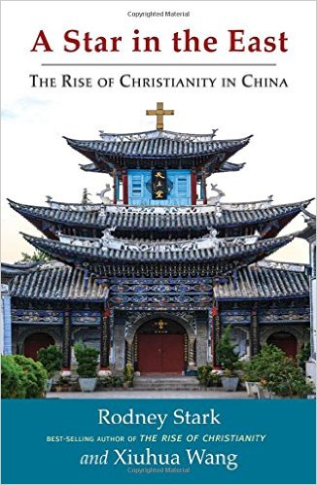
神的救恩故事
基督教在西方
中國基督徒的成長
2015年:為6-8千萬
2035: 2.4-2.8 億
Notes:
基督教在西方
後基督教文明 - 文化和歷史基督教
內部人口統計 Internal Demographics
最近的移民動態 Recent Immigration Dynamics
1.2 百萬從中東和非洲 million from Middle East and Africa
大多數移民是穆斯林 Most of the immigrants are Muslims
到2050年歐洲將是穆斯林多數 By 2050 Europe will be Muslim majority
中國基督徒的成長
1955: There are 120,000 Christians
Assessment of 費正清 in 1960s: 在1800年和20世紀初期在中國傳教的努力被浪費了 – 基督教在中國沒有機會
60 Million in 2015: 斯塔克，羅德尼：東方之星：中國基督教的興起 Stark, Rodney: A Star in the East: The Rise of Christianity in China
2.4-2.8 億 in 2035
中國將是擁有最多基督徒的國家
中國基督徒1960 - 2040年間的增長率只有從 AD33到300 可以比較
The early church – from 120 to 300 million – 60% of Roman empire

Slide 11
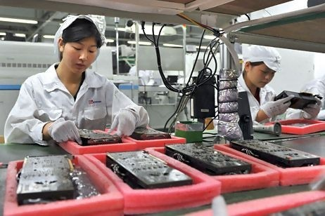
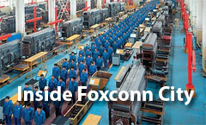
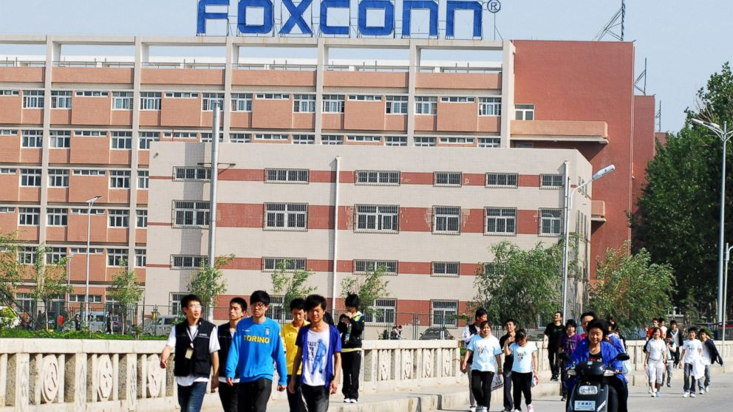
基督教在中國:背景
Notes:
在神學院/聖經學院教學
羊沒有牧人 -Sheep without Shepherd –
旁邊一個蘋果的製造廠有150000名員工建立蘋果產品
月薪：$ 374.09
工作10-12小時。
在這些製造廠內，充滿了鬱鬱寡歡的年輕人，從鄉村漫長的路遠。
Inside these plants, full of depressed young people who are long long way from home from the villages.
人們經常跳出他們的生活區，並自殺
People regularly jump out of their living quarters and commits suicide
許多工人將他們的孩子留在村莊來找工作-希望找到更好的機會; 沒有朋友，支持
離開家和朋友

Slide 12
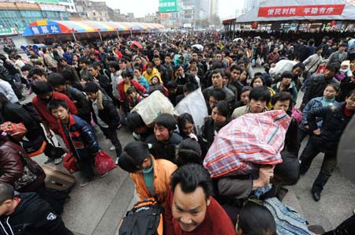
Notes:
Economist projects ???

Slide 13
以斯帖:難以想像的女主角
孤兒, 女孩
從一個被征服的種族
成為波斯皇后
宗教上:不聖潔
政治上:自己國家的人民的叛徒/ 漢奸
Notes:
以斯帖被波斯文化同化: Hadassah 哈大沙 (Hebrew) /Esther(Persian Name)以斯帖 (2:7)
末底改是以斯帖的堂兄 Esther is Mordecai’s uncle’s daughter
女王不聽話而被放逐 The queen of Xererx was disobedient and was exiled
國王決定挑選最美麗的女孩成為下一個王后
選美準備/美化 - （2:12 - 六個月用沒藥油和六個月的香料）The preparation/ beautifying – (2:12 – six months with oil of myrrh & six months with spices/ ointments)
與國王一個晚上
A girl
Uneducated
Without prominent family background (conquered race in exile)
Defiled herself according to the traditions of Jews – food laws, sexual ethics,
Work with foreign king – a traitor
她的成就今天在普珥節節日仍然被希伯來人記念
Her accomplishment is still remembered today in the festival of Purim
她在她的生命的關鍵時刻，當神的使命在她身上時，她的勇氣被記入聖經
She is remembered for her courage at the pivotal moment of her life when God’s Mission is upon her

Slide 14
難以想像的女主角
Notes:
There is a desperate need for biblical interpretation training in China – which some effort has been put into from Chinese Americans and other mission agencies – who translates bible commentaries / books into English
(My mother was a editor in such an organization in early 1990s – very lacking in resources);
She did not have a seminary degree – in fact it was during her most difficult time in life, just found out that my father was having an affair
They needed much help in interpretation of scripture
My Mom’s book pop out of the drawers; in the middle of nowhere; we like the BWGI material to pop out where.
BWGI material is exactly what Chinese Christians need in this moment of History
I want to see in 10 years, when I go to Bible college/ Seminary, they have BWGI material as their spiritual formation course!
Where many faithful servant of God would develop a deep understanding of God’s love and acceptance for them, and their ministry would flow out of that experience of Father’s love.
Furthermore, with deep biblical foundation and understanding of theology of emotions, they will be able to meet the huge family, relational crisis that is taking place within Chinese culture.
BWGI will play a huge role in the transformation of Christians in China, and thus the transformation of China

Slide 15
神救恩故事​中的主角
做生意
作為教師
回國探親
照顧你的侄子和侄女
輔導抑鬱的人
你在​神的救恩故事​中有份?

Slide 16
以斯帖的掙扎
末底改…吩咐她進宮見王,向王求情,為自己的族人在王面前懇求… ¹¹“王所有的臣僕和各省的人民,都知道有一個定例”-- 沒有奉召就擅入內院去見王的,除非王向他伸出金杖,賜他免死,一律要處以死刑.
大家都知道的一般
常識,認知,定律

Slide 17
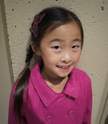
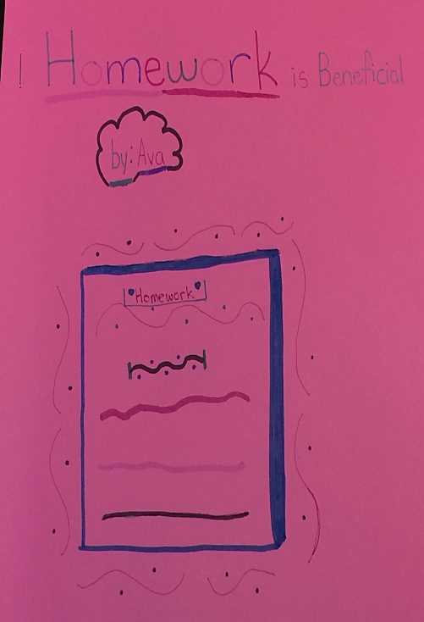
大家都知道 Why Homework is Beneficial?
Doing homework get you into a good college – like UCLA, Stanford, and CAL. So When you grow up, you can get into a better job like Apple & Google which gives you a high pay. ”
-- By Ava Wang 王沛恩

Slide 18
以斯帖的掙扎
你不要心裡想,你在王宮裡比所有的猶大人都安全。¹⁴ 這時你若是緘默不言,猶大人必會從別的地方得著解救…
地位
別人對你的看法
人身安全

Slide 19
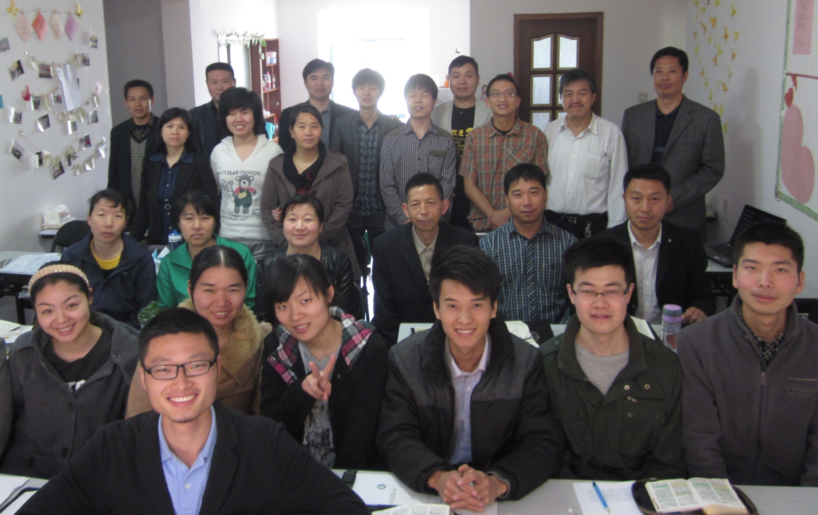
Notes:
I was teaching at a unregistered church leader’s gathering – they are at the front line of ministering to these people.
The younger students in front 22-30, they work with migrants working in their city
The older students in the back 35-50, they work with many who are left behind in the villages
They also will tell me – “PRAISE the Lord” that I can make it to this training – Police was just interrogating me 3 hours before
Struggle of Young Christian Pastors in China:
Earning 1/3 of their peers
Being disowned by their parents
Their children have no school to go to
Older Students:
Real physical persecution
They were interrogated by police right before they can show up for class

Slide 20
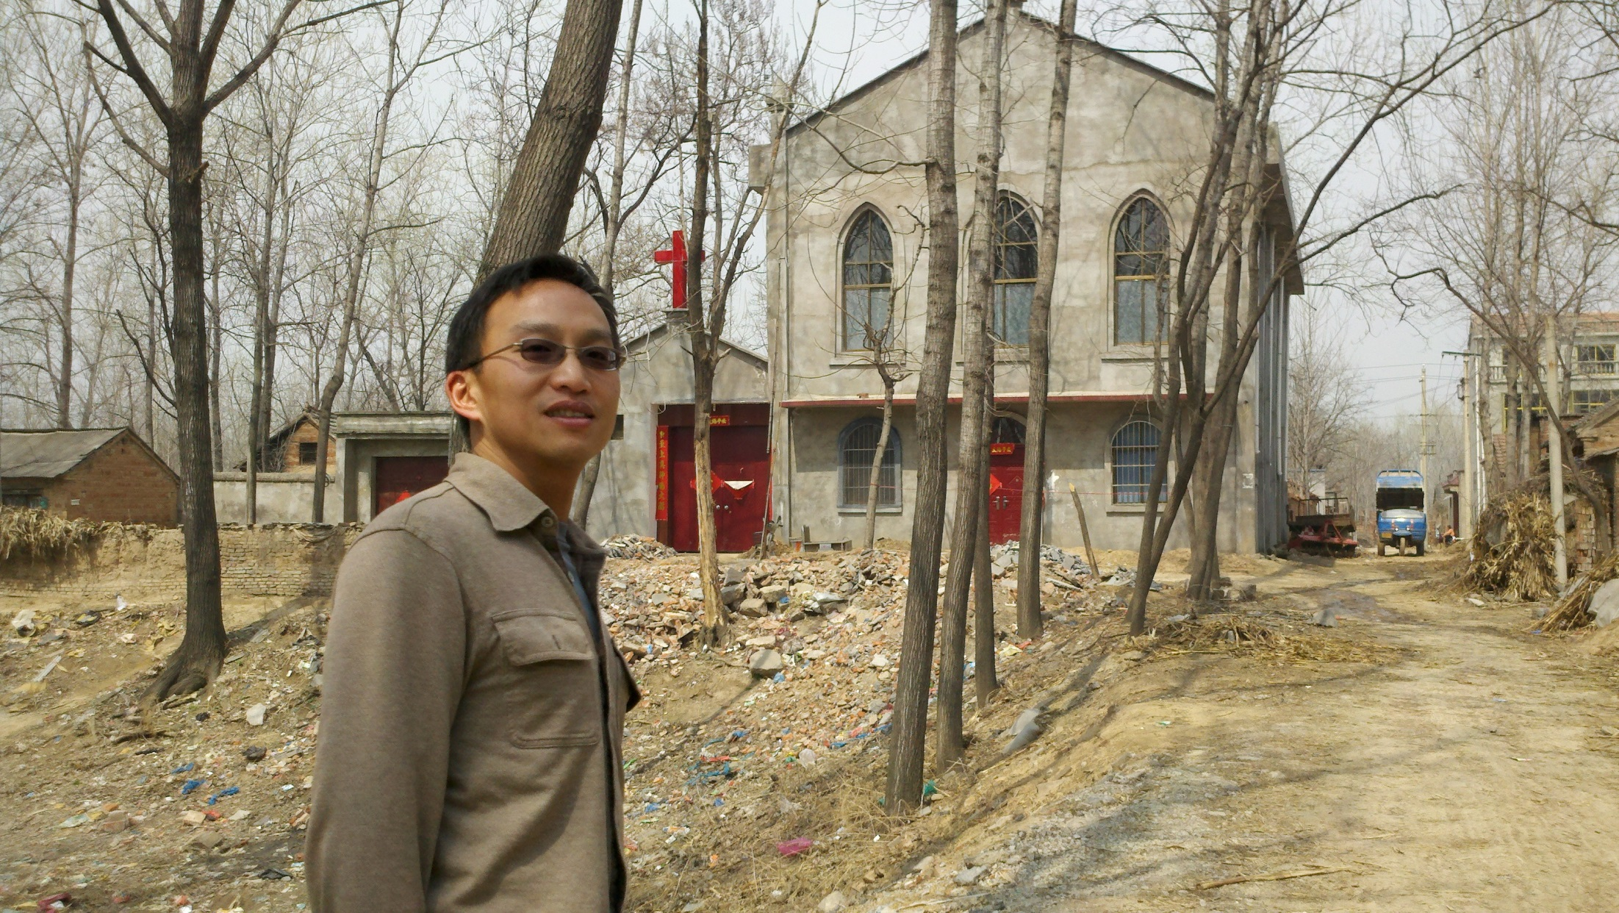

Slide 21
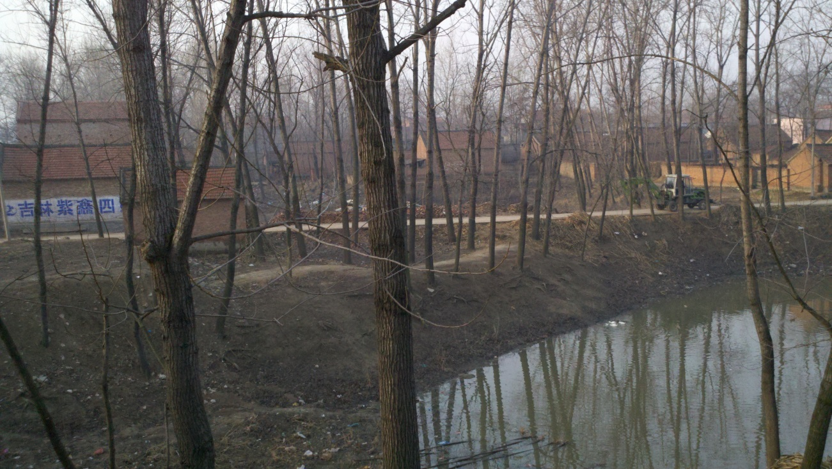
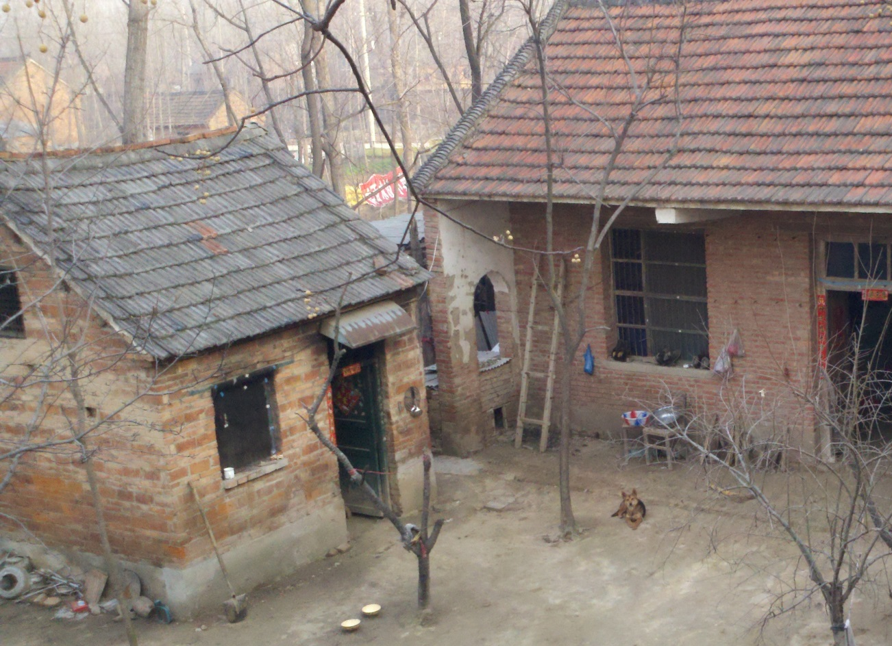
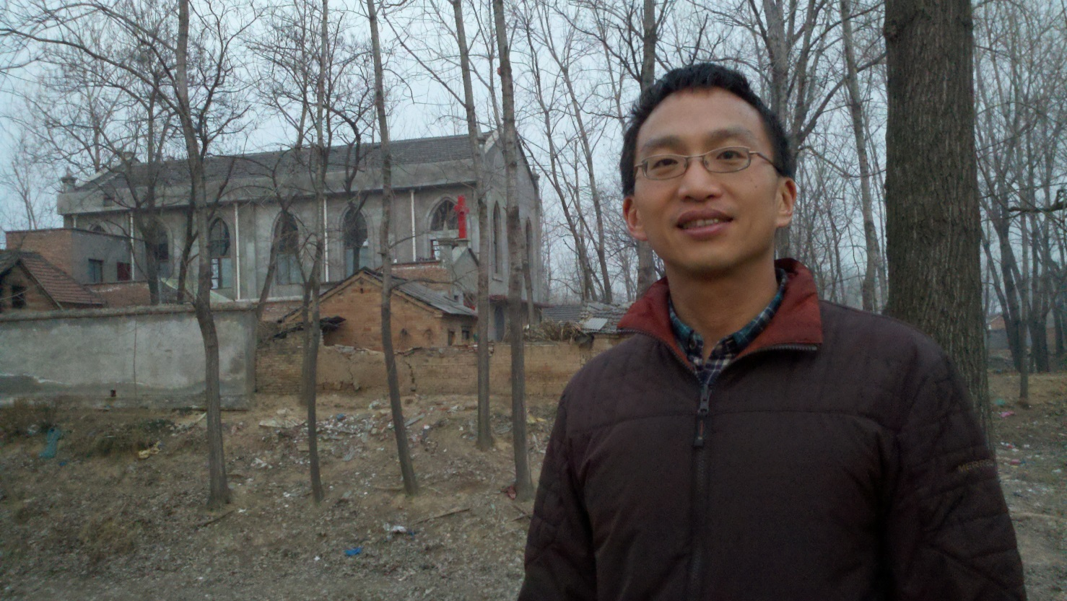
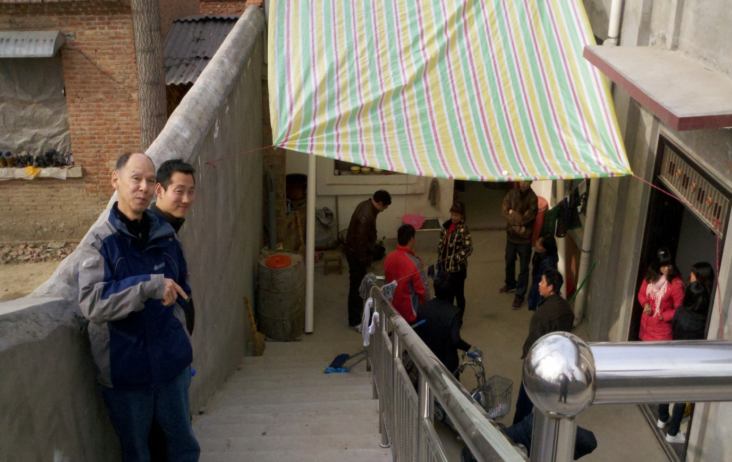

Slide 22
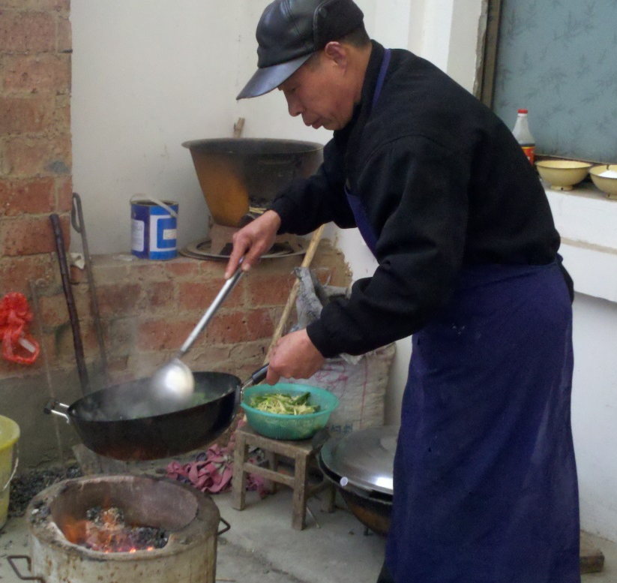
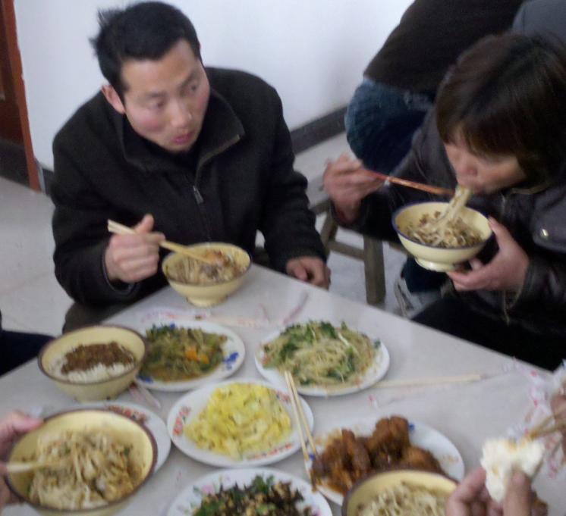
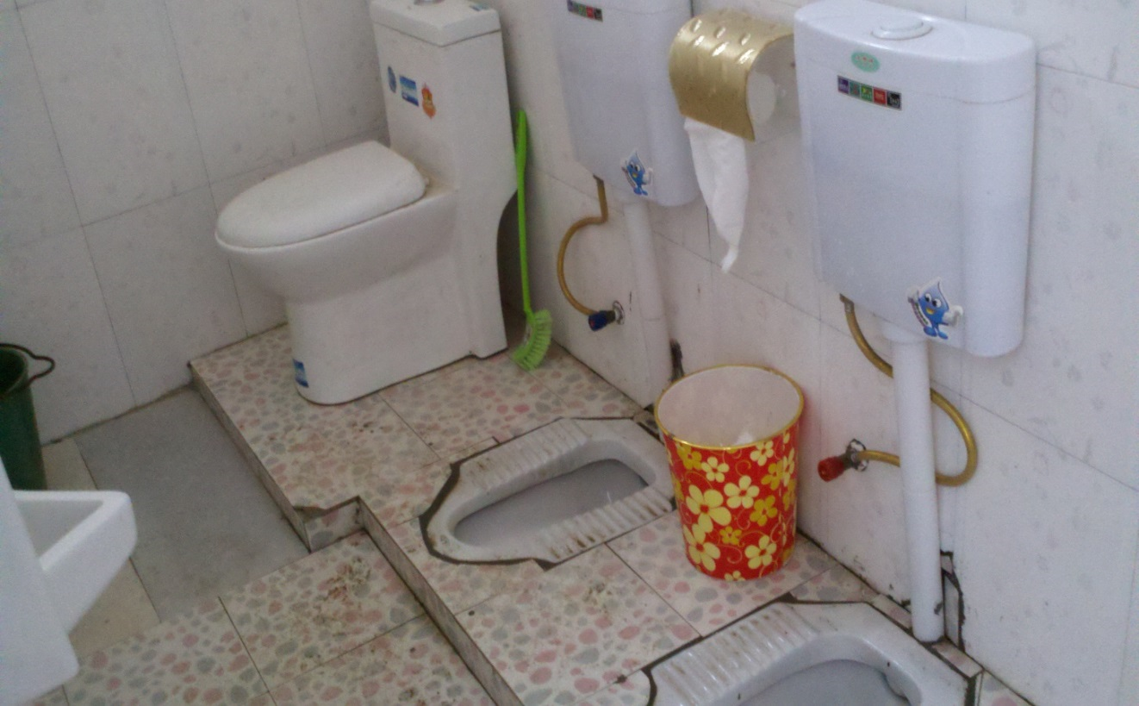
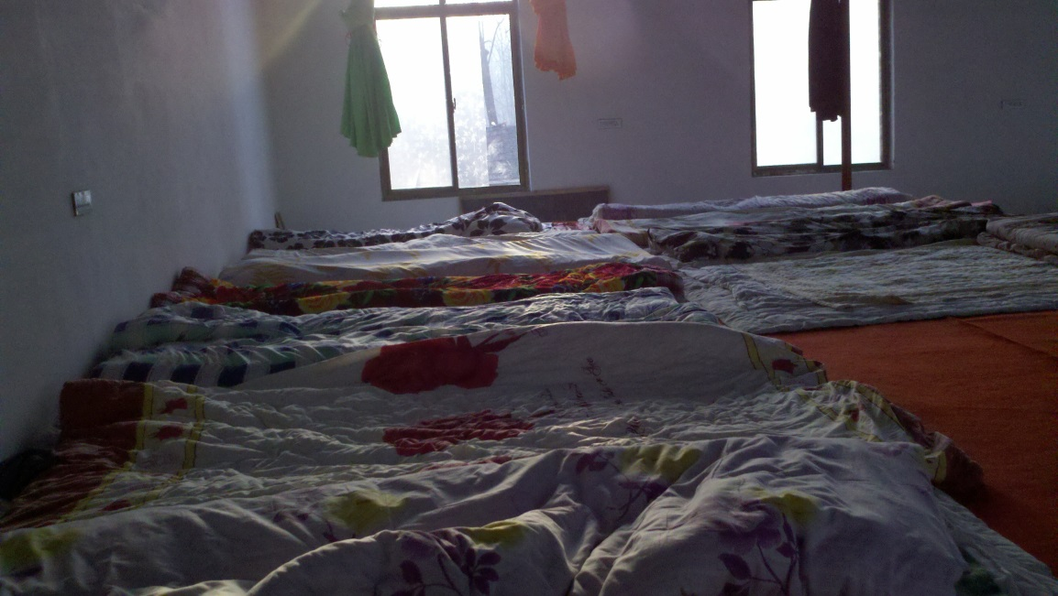

Slide 23
我們的掙扎?
舒適的生活方式
我們對退休的概念
我們的安全感: 錢財
我的希望和夢想,對孩子的期望
我的生活中有那些: “大家都知道”的“常識,認知,定律”- 需要被挑戰，以便你回應上帝
Notes:
Comfortable Lifestyles (playing ultimate)
I love exercise, working out in a gym but cannot do it in China
I brought a pair of running shoes traveling in BJ – not possible to run out door, so I just climb the stairs in the high rises
Our concept of retirement & security
Fundraising is very difficult – never had to do it. … being a church pastor is so much more stable
How much is enough for retirement?
Our Hopes and Dreams
People have personal ambitions – start a company, raise a family, find a wife
(James 4) We ask God with wrong motive: This is why God does not answer our prayers or request
B/c we confine God with our multiple choice questions
Should I live in SF or SJ or Oakland
God When should I stop working – “When I have 5 millions in asset or 10 millions”?
EX: Belize lady trying to retire
We need to examine our assumptions and say God, we are sacred and weak, and we need your help.
Instead of giving God multiple choice question: Ask him open ended questions? What do you think about this?
My current struggle: How to really help financially the church in China?
They don’t have organization, how do you purchase a building?
NO non-profit: how do you give?

Slide 24
以斯帖的勇氣
¹⁵以斯帖吩咐人回覆末底改說:¹⁶ “你要去,把書珊城所有的猶大人都召集起來,為我禁食三天,就是三日三夜不吃不喝;我和我的婢女也要這樣禁食。然後我就違例進去見王;我若是死,就死吧。” ¹⁷ 於是末底改離開了,照著以斯帖吩咐的一切去行。

Slide 25
以斯帖的勇氣
焉知你得了王后的位分，不是為現今的機會嗎？
誰知道 - 你為什麼在這個特殊的時刻成為王后？
耶穌死在十字架上拯救世人
在禱告中踏出信心的一步
回應神給你的機會
Notes:
WE will also have courage when we
Prayer: We ask God open ended questions – when He answers us, his own presence and confirmation / unity of believers together
Step out in Faith:
We cannot have everything under our control, then it would not be faith – faith and risk comes hand in hand
IF you are not willing to risk – then stay in your palaces – the comfort of your own home – but salvation will come from somewhere else!
Respond to Opportunity
You are placed here, in the Bay Area with one of the highest concentration of Asian Americans for a reason
You are a doctor, a teacher, a engineer, a student for a reason, Respond to God’s calling for your church and take the opportunity to step out in faith as a community

Slide 26
在​神的救恩故事​中有份
在基督教歷史的過渡
你可以成為-神救恩故事​中的主角
因為經歷了神的愛-我們有回應祂的勇氣
Notes:
Transition in Christendom
You can be an Unlikely Hero: God calls the most unlikely people to carry out his mission
Struggles are Real
Jesus struggled: when he was praying, he also asked God the Father to take the cup away if possible
The Courage to Respond
The courage does not come from ourselves, but experiencing the Love of Christ
Seeing the Sheep without shepherd – the Needs
The confirmation of believers
Step out in Faith against reason sometimes – take great risks for God
The desire to participate in God’s salvation story!
Esther: Memorize in the festival of Purim that is still being celebrated by Jews today
I was on the airplane reading Business Week, and they were ranking 2013’s top 100 Venture Capitalist, and I saw a friend of mine’s name on # 48, he invested in Nest and some other medical device company and made lots of money
I can only imagine that in the book of church history, and at a particular transition – a Time Such as This, that YOUR church’s name, and Your name will be up there in the book of life, knowing that you were part of this very exciting history of what God is doing in the world

Slide 27
在​神的救恩故事​中有份
誰知道 - 你為什麼在這個特殊的時刻
基督教歷史的過渡
中國基督教的興起
來到硅谷, 全世界的高科技中心
在​神的救恩故事​中有份
Notes:
Transition in Christendom
You can be an Unlikely Hero: God calls the most unlikely people to carry out his mission
Struggles are Real
Jesus struggled: when he was praying, he also asked God the Father to take the cup away if possible
The Courage to Respond
The courage does not come from ourselves, but experiencing the Love of Christ
Seeing the Sheep without shepherd – the Needs
The confirmation of believers
Step out in Faith against reason sometimes – take great risks for God
The desire to participate in God’s salvation story!
Esther: Memorize in the festival of Purim that is still being celebrated by Jews today
I was on the airplane reading Business Week, and they were ranking 2013’s top 100 Venture Capitalist, and I saw a friend of mine’s name on # 48, he invested in Nest and some other medical device company and made lots of money
I can only imagine that in the book of church history, and at a particular transition – a Time Such as This, that YOUR church’s name, and Your name will be up there in the book of life, knowing that you were part of this very exciting history of what God is doing in the world

Slide 28
Discussion Questions
Anything new you learned about the historical context we are living in ? What excites you about the context of our time?
How is Esther an Unlikely Hero? Can you be an unlikely hero? Why or why not?
What are some conventional wisdoms you live under? Where did you get them from? Your parents? Friends? Cultural trend?
How do they limit you from participating in God’s Story for YOU?
What might be some of your fears? Who can you pray with to overcome these fears?

